Slide 1

5 DAYS WITH PYTHON
DAY 3
Speaker: KRUTIKA VINCHU

Slide 2
5 DAYS WITH PYTHON
DAY 3
Speaker: KRUTIKA VINCHU

Slide 3

What we learn today…
Lesson 1
Lesson 2
Lesson 3
Lesson 4
Lesson 5
Variable and their naming conversions
Data types(int, lists, numbers, tuples, strings, dictionaries, set)
Type Conversion of data type
Array Operations
Difference between Python lists and arrays
.

Slide 4
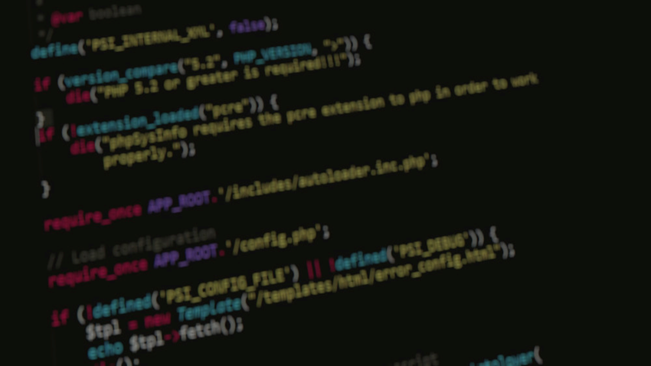
PYTHON VARIABLE

Slide 5
PYTHON VARIABLE

Slide 6
Variable in python
a=python
b=3
Print(a+str(b))
:python3
del “var_name”
del a
a=100
Print(a)
:100
1. Declare and Use a variable
Reserved memory location to store values
3. Delete a variable
A variable is created the moment we first assign a value to it.
2. Concatenate Variables
The value stored in a variable can be changed during program execution.
Variables do not need to be declared with any particular type, and can even change type after they have been set.

Slide 7

Type
Start with a letter or the underscore
Cannot start with a number
Contain alpha-numeric characters and underscores (A-z, 0-9, and _ )
case-sensitive (age, Age, AGE)
Camel Case
myVariableName = “SIGCE"
Pascal Case
MyVariableName = " SIGCE "
Snake Case
my_variable_name = " SIGCE "
x = str(3) # x will be '3'
y = int(3) # y will be 3
z = float(3) # z will be 3.0
Casting
Quotes
x, y, z = “HackClubSIGCE"
One value to multiple variable
x = ‘’HackClubSIGCE"
x = 'HackClubSIGCE’ }both are same
x, y, z = “Hack", “Club", “SIGCE"
x = 5
print(type(x))
:: <class 'int'>
Assign Multiple Values
Naming
Convention
a = 4
A = "SIGCE"
Case Sensitive

Slide 8

Variables in python
PyObject
Integer
1
Type
Reference
count
X = 543
Value
543
X
X = 142
PyObject
Integer
1
Type
Reference
count
Value
142

Slide 9
Variables in python
PyObject
Integer
1
X = 543
Type
PyObject
Integer
2
X
Reference
count
X = 142
Type
Value
142
Reference
count
Y
Y = X
Value
142
Del X

Slide 10
Variables in python
X = 543
PyObject
Integer
1
X = 142
Type
Y
Reference
count
Y = X
Value
142
Del X

Slide 11
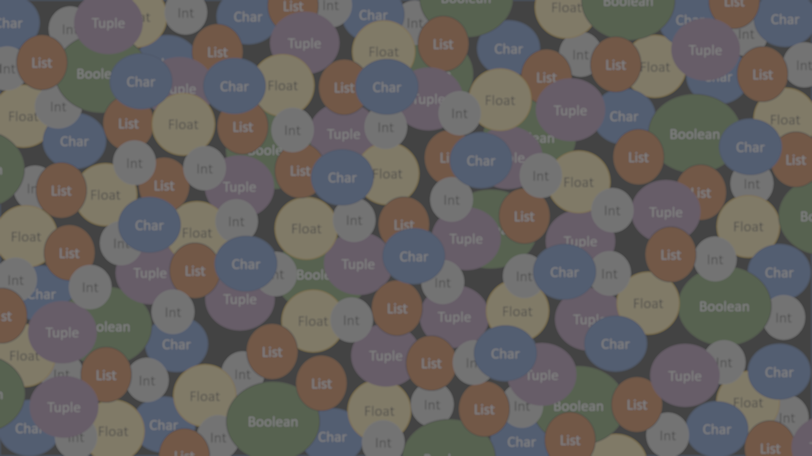
PYTHON
DATA TYPES

Slide 12
PYTHON
DATA TYPES

Slide 13
Data Types In Python
.
Sequence
Text
Mapping
Set
Numeric
Boolean

Slide 14
Data Types In Python
.
Sequence
Bool
Text
Mapping
Set
Numeric
Boolean
String
Set
List, Tuple
Dictionary
Int, Float, Complex

Slide 15
Data Types In Python
Slicing
Modify
Concatenate
Text
(String)
Format
Methods

Slide 16
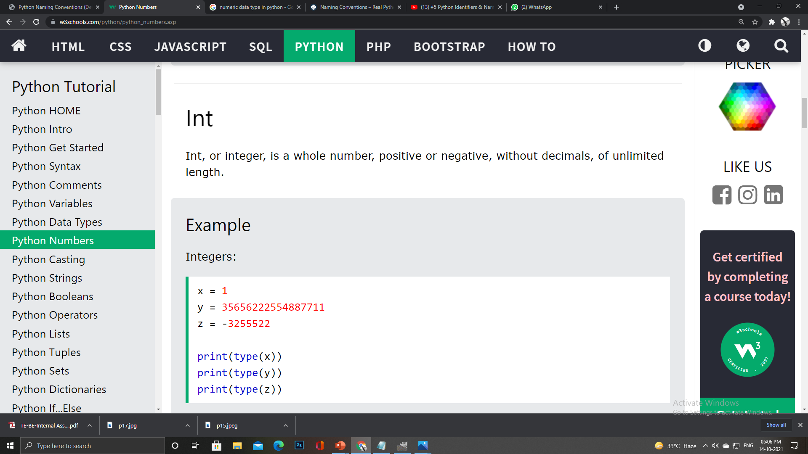
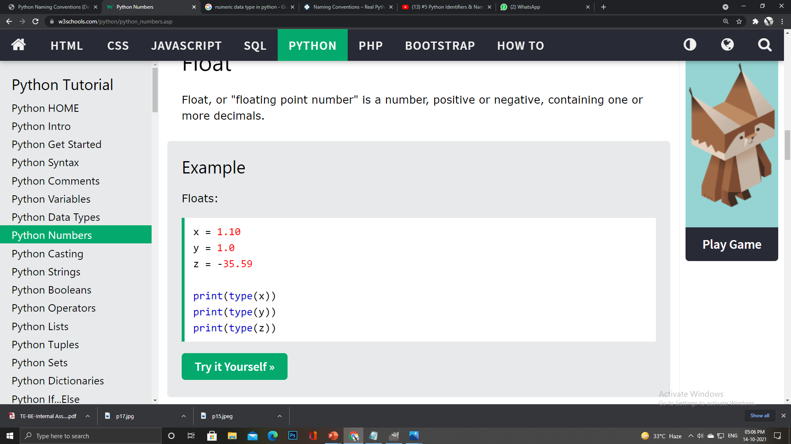
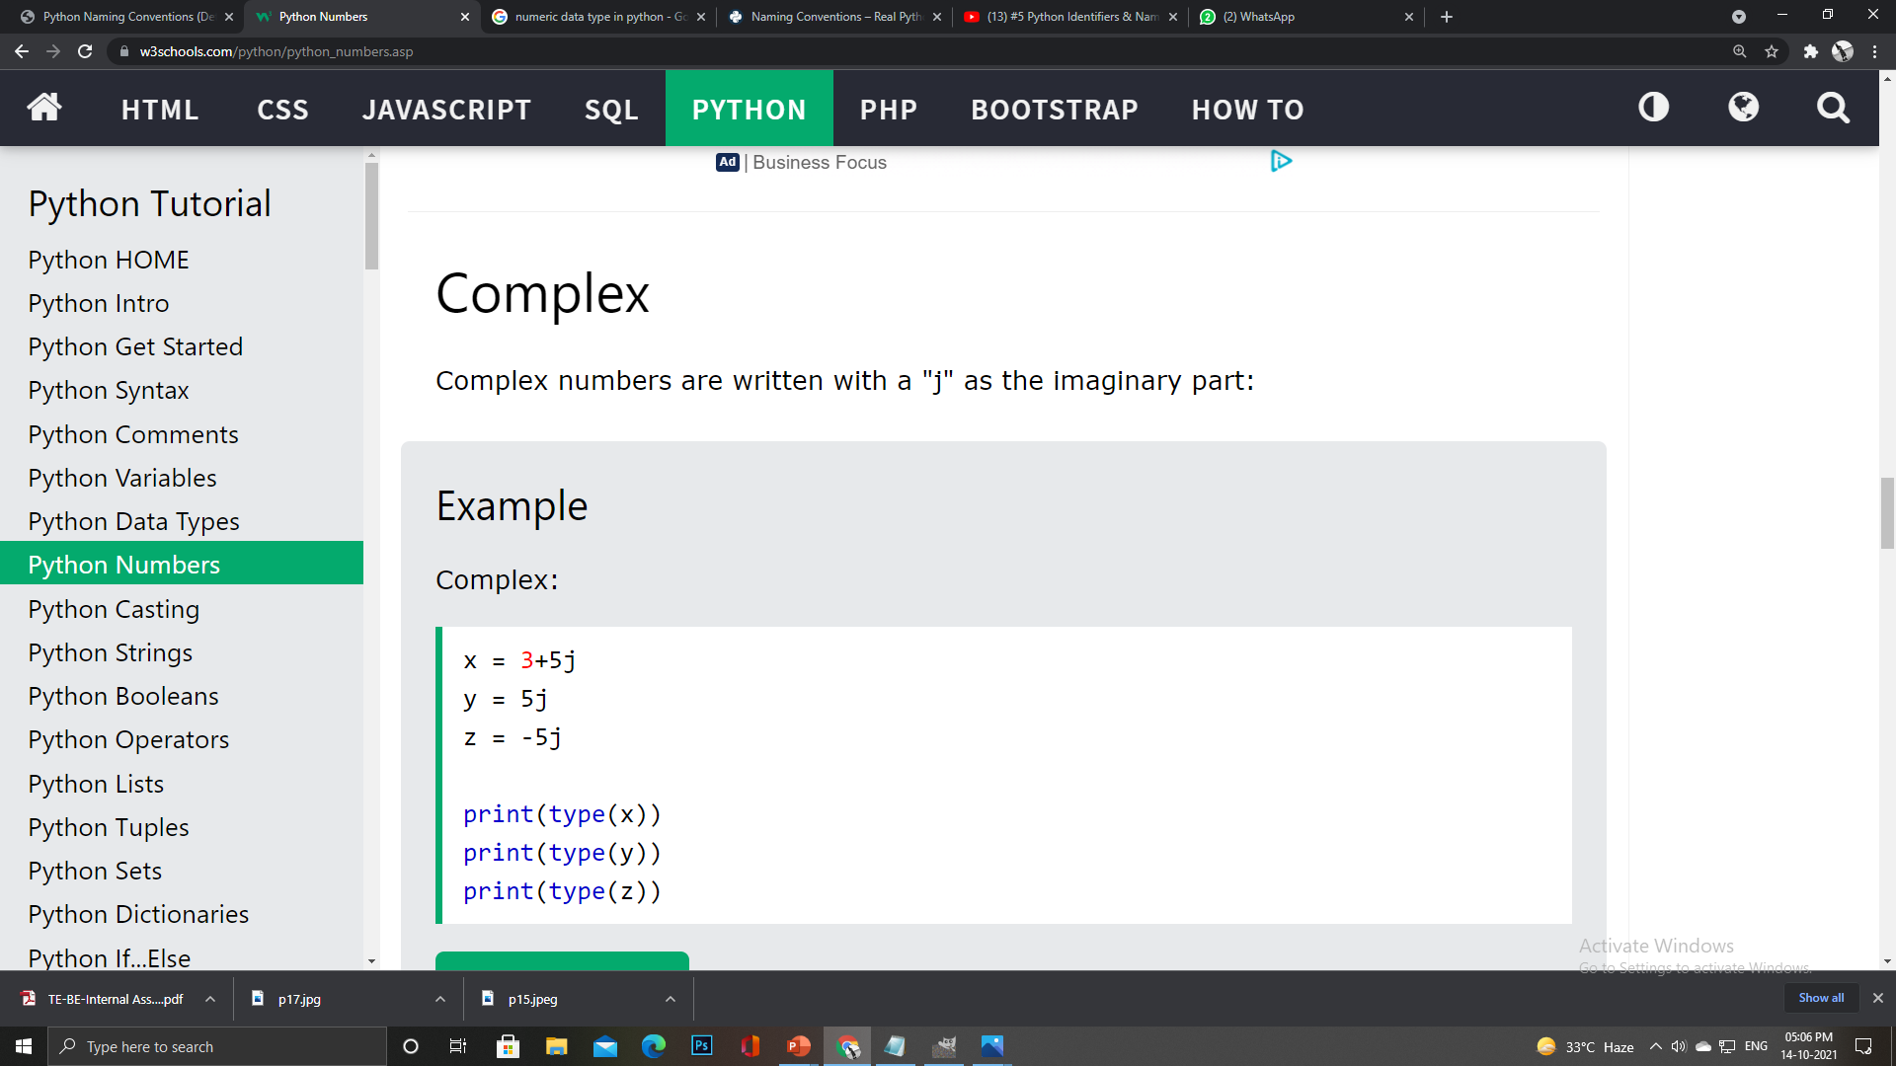
Data Types In Python
Numeric
(int, float,
complex)
Integer
Float
Complex

Slide 17
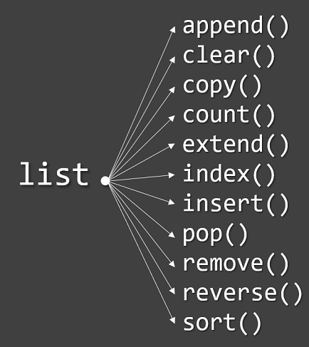
Data Types In Python
mylist = [“Hack", “Club", “SIGCE"]
Sequence
(List)
Multiple items in a single variable
List items are ordered, changeable, and allow duplicate values.
A single list may contain Data Types like Integers, Strings, as well as Objects
Lists are mutable, and hence, they can be altered even after their creation.

Slide 18
Data Types In Python
Access
Update
Sequence
(Tuple)
Methods
ordered and immutable
Tuples are written with round brackets.
tup1 = ('physics', 'chemistry', 1997, 2000);
tup2 = (1, 2, 3, 4, 5 );
tup3 = "a", "b", "c", "d";

Slide 19
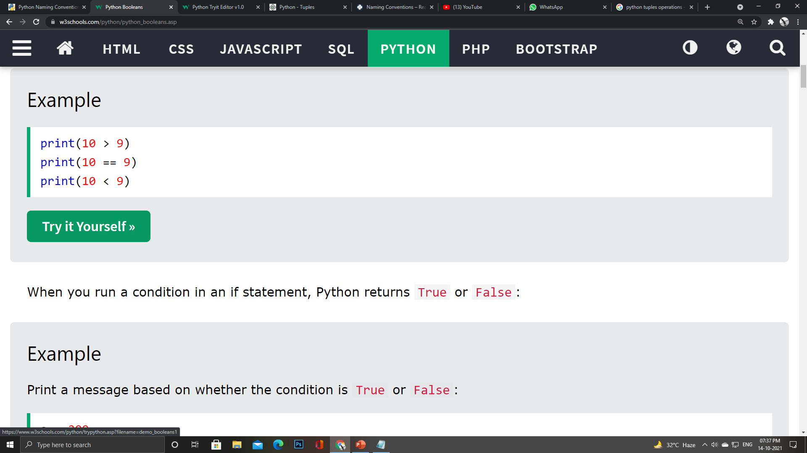
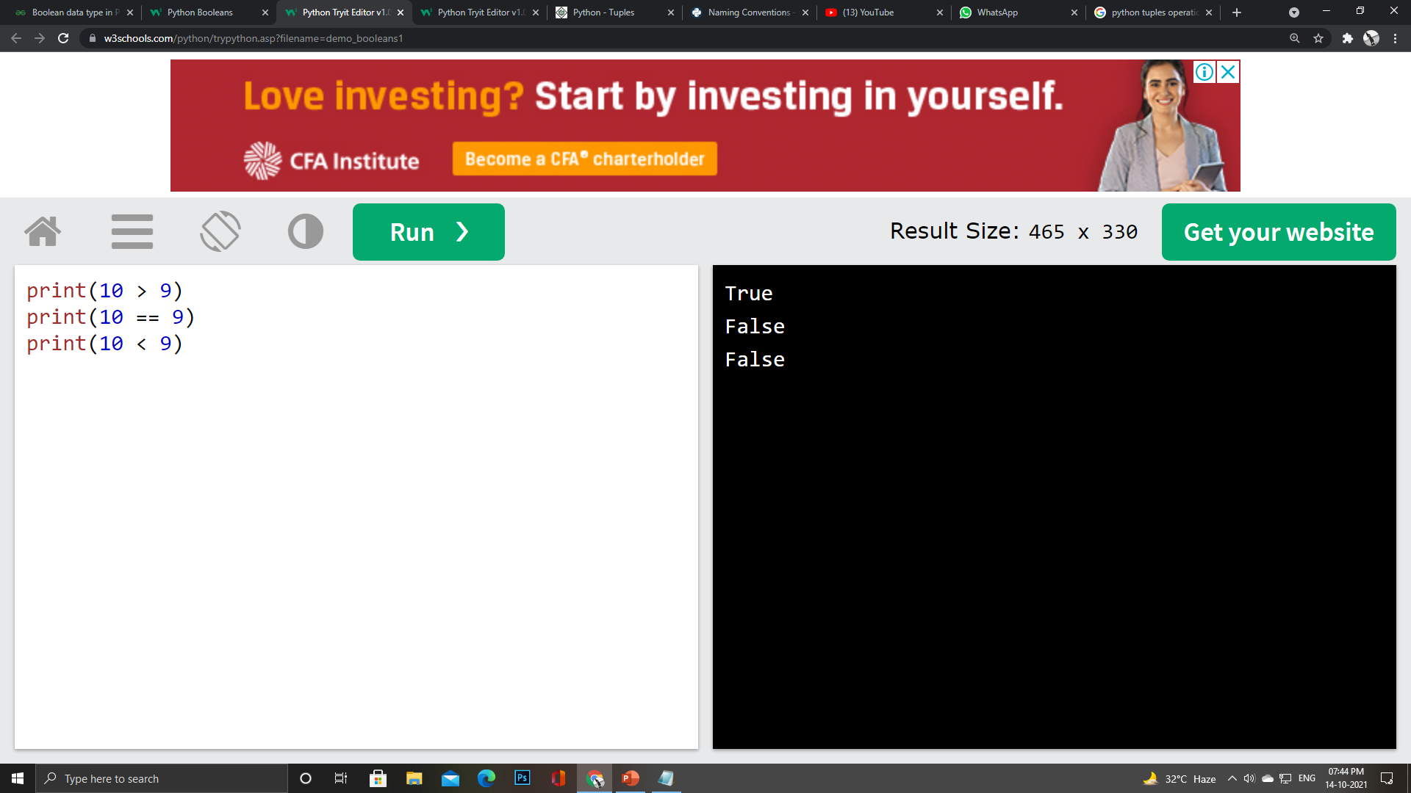
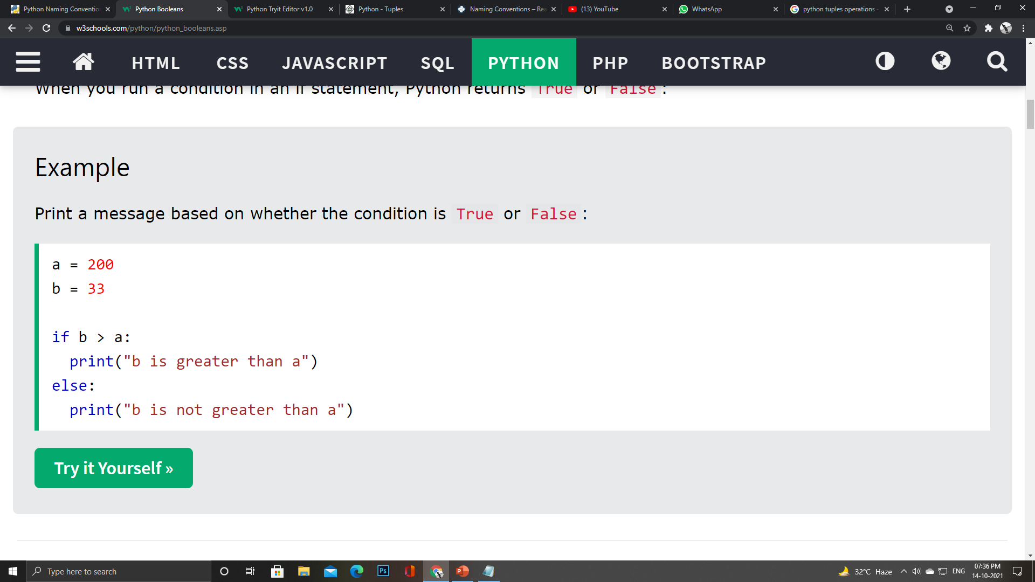
Data Types In Python
Boolean
Represents one of the two values i.e. True or False
Used to represent the truth values of the expressions
True and False must have an Upper Case first letter

Slide 20
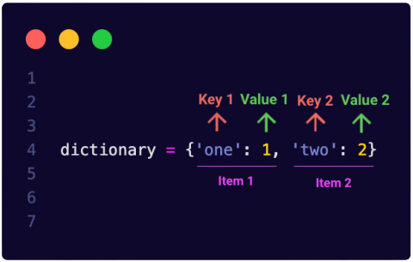
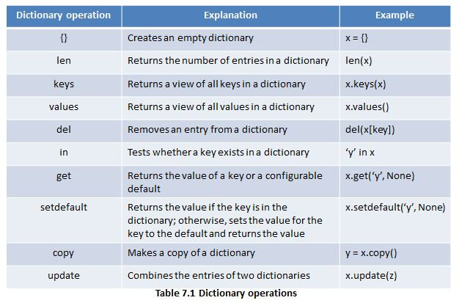
Data Types In Python
Mapping
(Dictionary)
Store data values in key:value pairs.
A dictionary is a collection which is ordered, changeable and does not allow duplicates.
Dictionaries are written with curly brackets, and have keys and values:

Slide 21
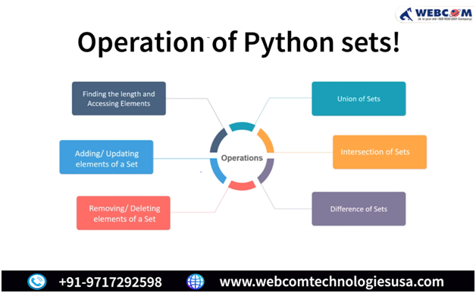
Data Types In Python
myset = {“Hack", “Club", “SIGCE”}
Sets
A set is a collection which is both unordered and unindexed.
Once a set is created, you cannot change its items, but you can add new items.

Slide 22

TYPE CONVERSION IN PYTHON

Slide 23
TYPE CONVERSION IN PYTHON

Slide 24
Type Conversion In Python
Type Conversion
Python interpreter automatically converts one data type to another without any user involvement.
Implicitly
Explicitly
In Explicit Type Conversion in Pythonthe data type is manually changed by the user as per their requirement.
int()
float()
hex()
oct()
tuple()
set()
list()
dict()
str()

Slide 25

ARRAY OPERATIONS
In python

Slide 26
ARRAY OPERATIONS
In python

Slide 27

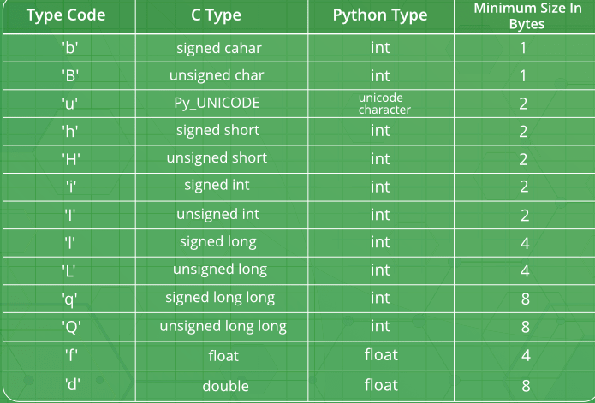
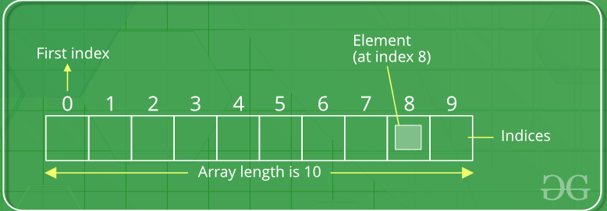
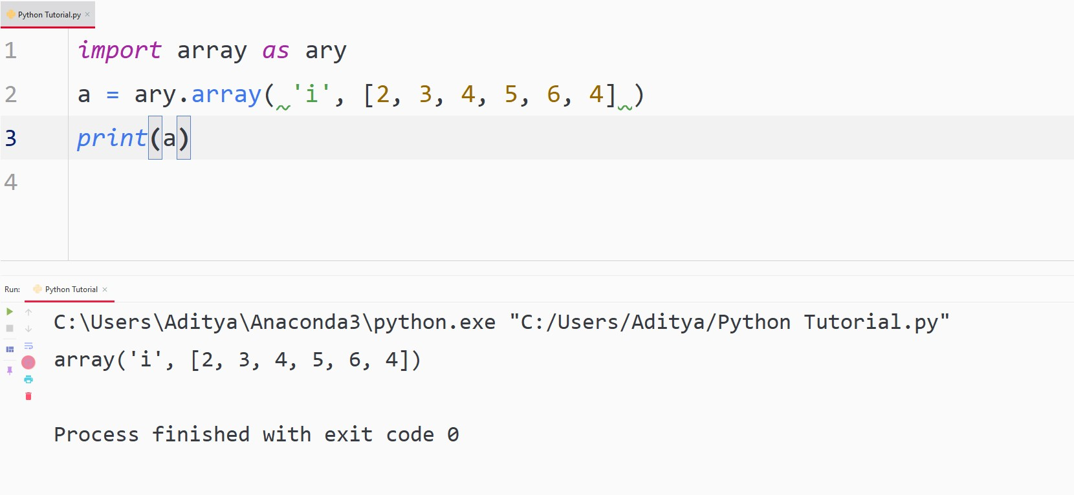
Python Array
01
Collection of Same items/data type stored at contiguous memory locations
Array in Python can be created by importing array module.
02
03
Advantage :
array in python has no fixed size
from array import *
arrayName = array(typecode, [Initializers])
array(data_type, value_list)

Slide 28




Array Operations
Search
Update
Insert
Delete

Slide 29
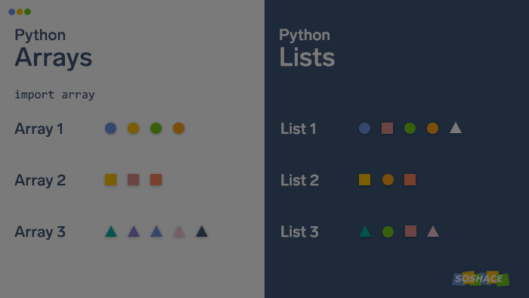
PYTHON ARRAY v/s LIST

Slide 30
PYTHON ARRAY v/s LIST

Slide 31
List | Array
1.Elements belonging to different data types
1. Elements belonging to the same data type
2. Greater flexibility allows easy modification (addition, deletion) of data
2.Less flexibility since addition, deletion has to be done element wise
3. No need to explicitly import a module for declaration
3. Need to explicitly import a module for declaration
4. Cannot directly handle arithmetic operations
4.Can directly handle arithmetic operations
5. Consume larger memory for easy addition of elements
5. Comparatively more compact in memory size
6. Preferred for shorter sequence of data items
6.Preferred for longer sequence of data items

Slide 32
Thank
You…

